Slide 1


Linear Algebra
Bhushan Poojary

Slide 2
What This Course Is About
Computer Graphics
Quantum Computing
Data Science and Machine Learning
Network Analysis
Engineering and Physics

Slide 3
What You’ll Learn
✅ Understand and visualize vectors, matrices, subspaces, and transformations ✅ Solve systems of equations and compute inverses, eigenvalues, and eigenvectors ✅ Apply SVD for dimensionality reduction and least squares for regression ✅ Understand orthogonality, diagonalization, and spectral theorems ✅ Use linear algebra in applications like PageRank, PCA, Markov chains

Slide 4
Who Is This Course For?
This course is perfect for:
University students studying math, engineering, or CS
Self-learners aiming to master machine learning, quantum computing, or 3D graphics
Researchers or developers who need solid mathematical foundations

Slide 5
Prerequisites
You don’t need to be a math expert, but you should be comfortable with:
Basic algebra (solving equations, manipulating expressions)
High-school level geometry (vectors, slopes, basic trigonometry)
Some exposure to functions and graphs
Optional but helpful:
Familiarity with matrix notation or basic programming (e.g., Python, MATLAB, NumPy)
Throughout the course, we’ll explain concepts from the ground up, but also provide advanced insights for those aiming to dive deeper.

Slide 6


Tools You May Use
While the course focuses on theory, you can follow along using tools like:
Python (NumPy, Matplotlib) for hands-on matrix computation and visualization
Matlab or Octave if you're from an engineering background
Geogebra or Desmos for vector visualization

Slide 7
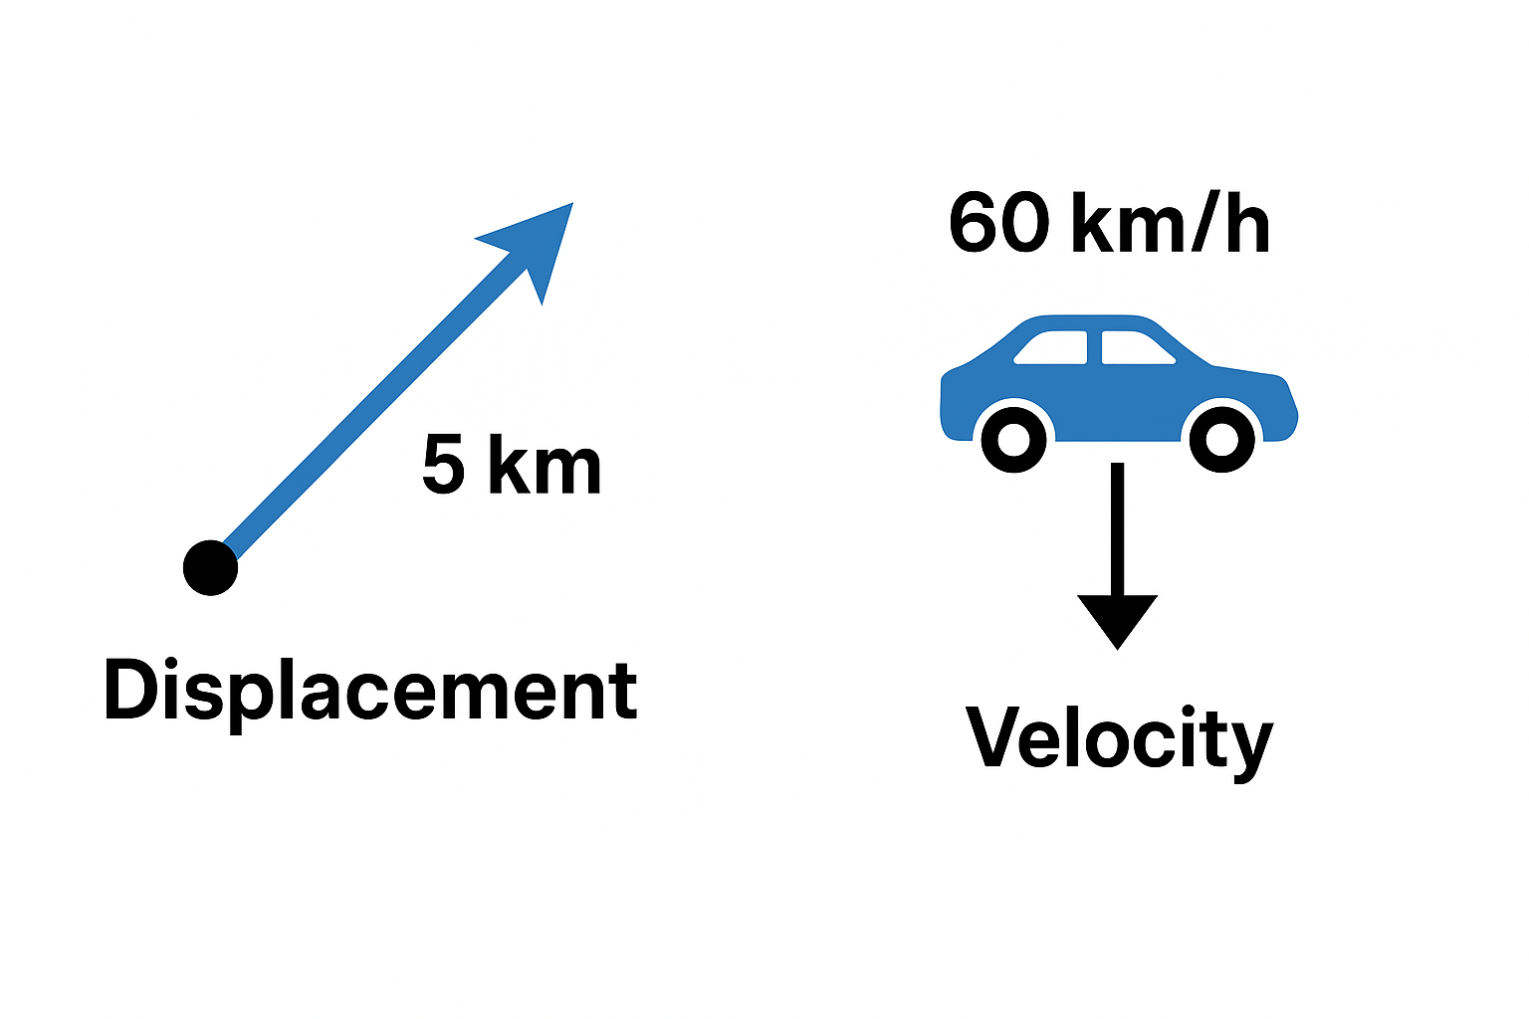
Vectors and Linear Combinations
What Are Vectors?
Analogy: Think of a vector as an arrow that points in a certain direction and has a certain length.
Real-life examples:
Displacement: 5 km northeast
Velocity: 60 km/h south

Slide 8
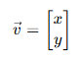
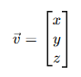
Vectors and Linear Combinations
Definition
A vector is a quantity with magnitude and direction.
In 2D, it looks like:
In 3D:

Slide 9
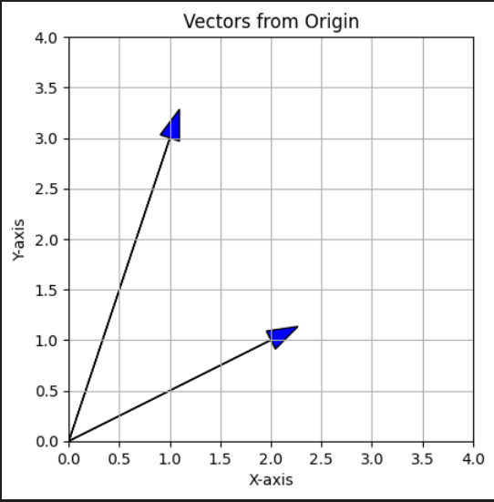
Vectors and Linear Combinations
Visual Demo (Using Python)
Vector (2, 1), (1, 3)

Slide 10
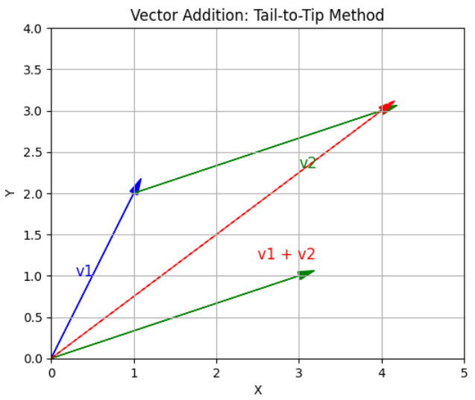
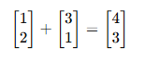
Vectors and Linear Combinations
Part 2: Vector Operations
➕ Vector Addition
"Tail-to-tip" method visually.

Slide 11
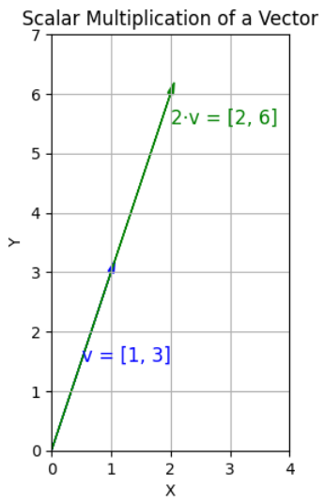
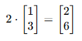
Vectors and Linear Combinations
✖️ Scalar Multiplication
Stretch or shrink a vector:

Slide 12
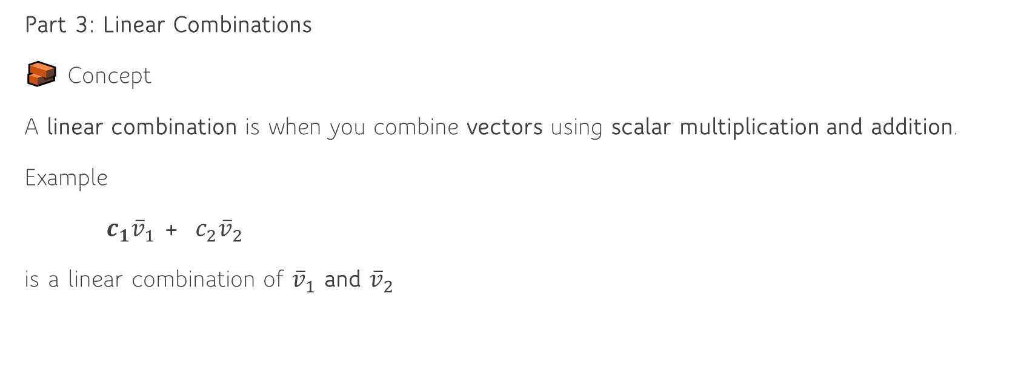
Vectors and Linear Combinations
Part 3: Linear Combinations
🧱 Concept
A linear combination is when you combine vectors using scalar multiplication and addition.
Example
$c_{1}{\overline{v}}_{1}$ + ${c_{2}\overline{v}}_{2}$
is a linear combination of ${\overline{v}}_{1}$ and ${\overline{v}}_{2}$

Slide 13
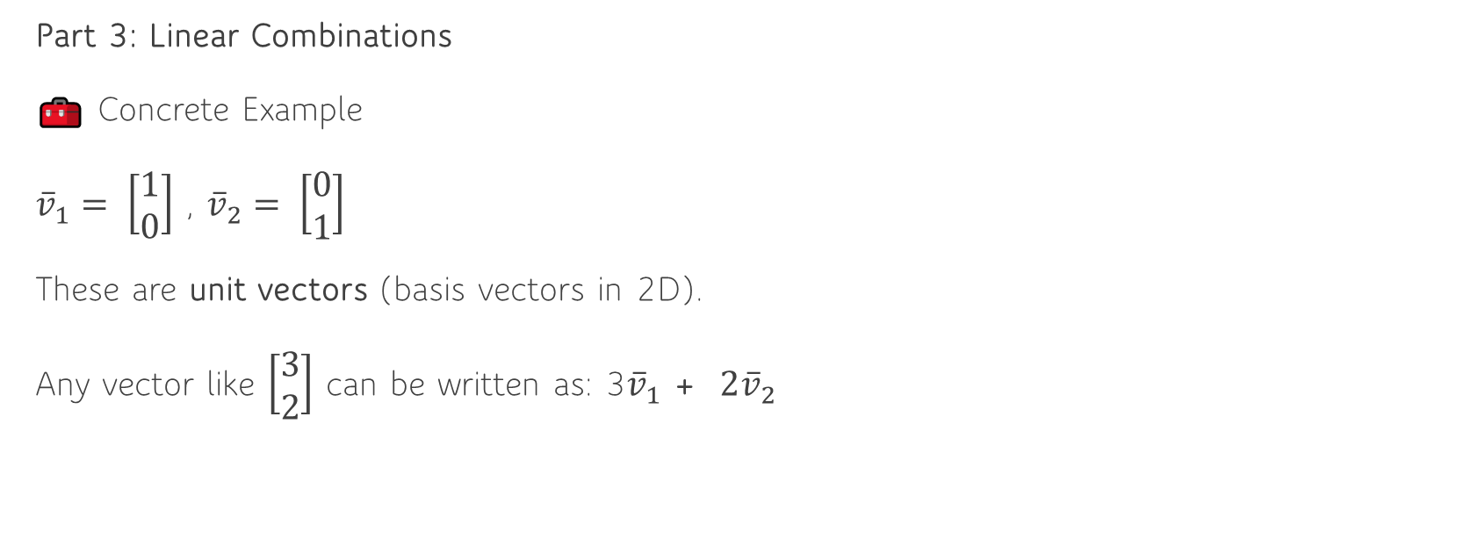
Vectors and Linear Combinations
Part 3: Linear Combinations
🧰 Concrete Example
${\overline{v}}_{1}= \left[\begin{matrix}1 \\ 0\end{matrix}\right]$ , ${\overline{v}}_{2}= \left[\begin{matrix}0 \\ 1\end{matrix}\right]$
These are unit vectors (basis vectors in 2D).
Any vector like $\left[\begin{matrix}3 \\ 2\end{matrix}\right]$ can be written as: 3${\overline{v}}_{1}$ + ${2\overline{v}}_{2}$

Slide 14
Vectors and Linear Combinations
Part 4: Why Linear Combinations Matter
They allow us to build new vectors from a few starting vectors (called basis vectors).
Foundation for solving systems of equations, understanding vector spaces, and building transformations.

Slide 15

Matrices and Linear Equations
Example: A coffee shop sells:
Espresso for ₹100
Latte for ₹150
Cappuccino for ₹200
If a customer buys 2 espressos, 1 latte, and 1 cappuccino,
what's the total bill?
2x + 1y + 1z = Total

Slide 16

Matrices and Linear Equations
Customer 1: 2x + 1y + 1z = 550
Customer 2: 1x + 3y + 2z = 850
Customer 3: 2x + 2y + 3z = 1000
This is a system of linear equations.

Slide 17
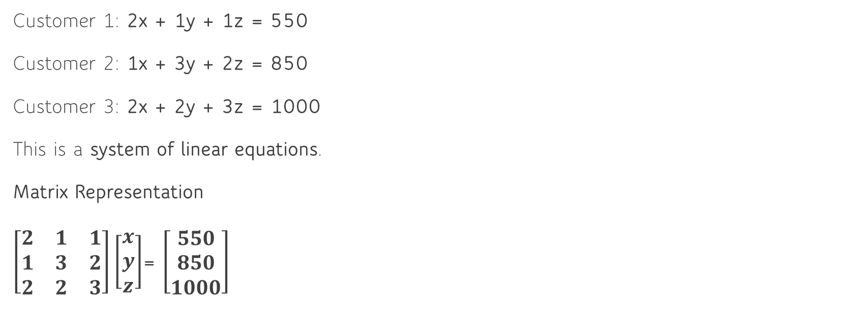
Matrices and Linear Equations
Customer 1: 2x + 1y + 1z = 550
Customer 2: 1x + 3y + 2z = 850
Customer 3: 2x + 2y + 3z = 1000
This is a system of linear equations.
Matrix Representation
$\left[\begin{matrix}2 & 1 & 1 \\ 1 & 3 & 2 \\ 2 & 2 & 3\end{matrix}\right]\left[\begin{matrix}x \\ y \\ z\end{matrix}\right]$= $\left[\begin{matrix}550 \\ 850 \\ 1000\end{matrix}\right]$

Slide 18
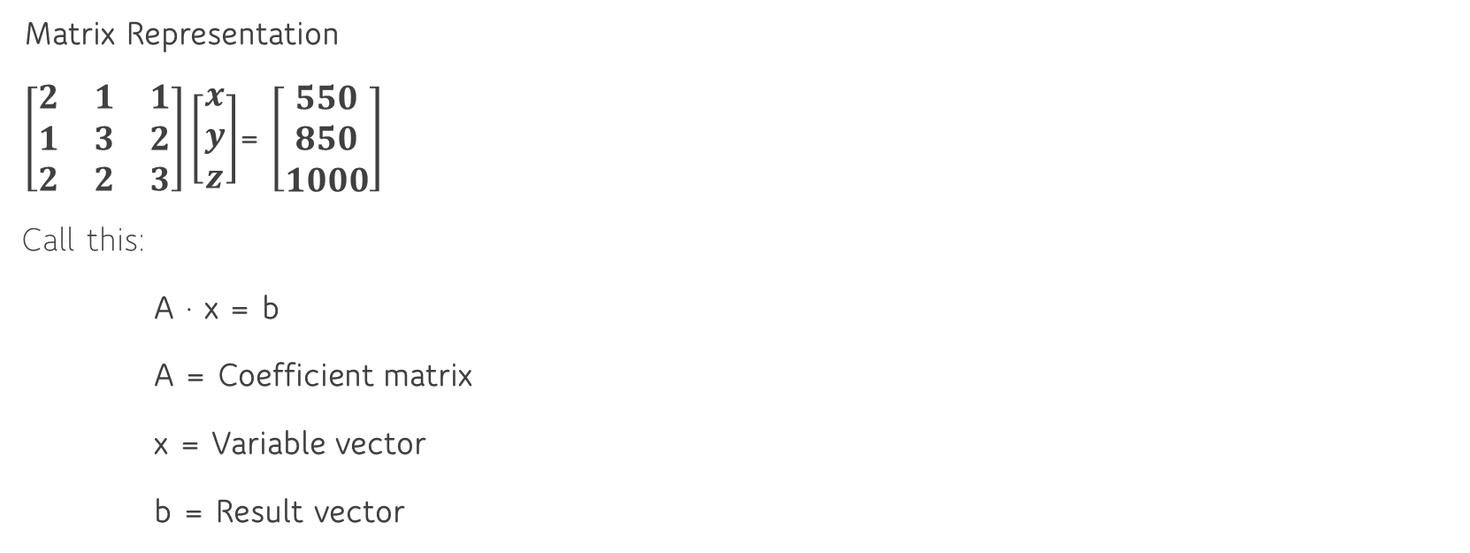
Matrices and Linear Equations
Matrix Representation
$\left[\begin{matrix}2 & 1 & 1 \\ 1 & 3 & 2 \\ 2 & 2 & 3\end{matrix}\right]\left[\begin{matrix}x \\ y \\ z\end{matrix}\right]$= $\left[\begin{matrix}550 \\ 850 \\ 1000\end{matrix}\right]$
Call this:
A · x = b
A = Coefficient matrix
x = Variable vector
b = Result vector

Slide 19
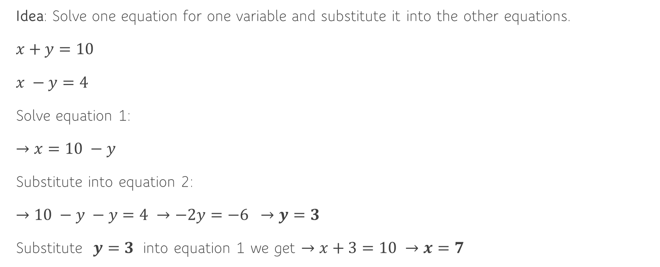
1. Substitution Method (Best for 2 variables)
Idea: Solve one equation for one variable and substitute it into the other equations.
$x+y=10$
$x −y=4$
Solve equation 1:
$→x=10 −y$
Substitute into equation 2:
$→10 −y −y=4 →−2y=−6 →y=3$
Substitute $y=3$ into equation 1 we get $→x+3=10 →x=7$

Slide 20
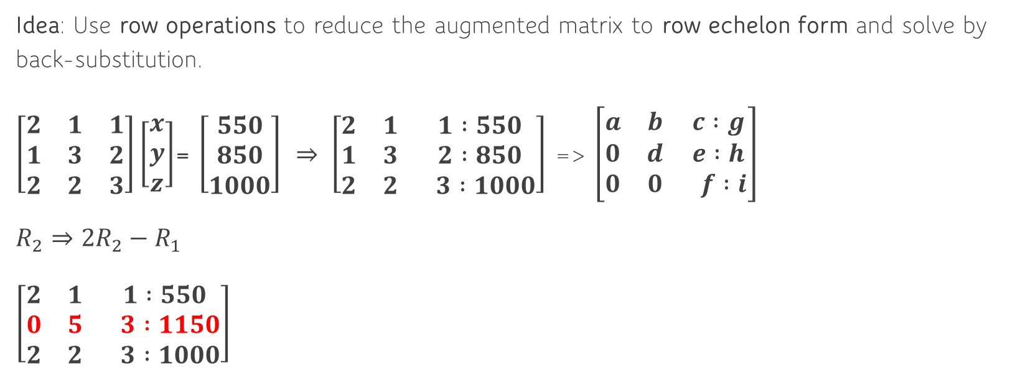
Gaussian Elimination (Best for hand-solving 3×3 or 4×4 systems)
Idea: Use row operations to reduce the augmented matrix to row echelon form and solve by back-substitution.
$\left[\begin{matrix}2 & 1 & 1 \\ 1 & 3 & 2 \\ 2 & 2 & 3\end{matrix}\right]\left[\begin{matrix}x \\ y \\ z\end{matrix}\right]$= $\left[\begin{matrix}550 \\ 850 \\ 1000\end{matrix}\right]$ $⇒ \left[\begin{matrix}2 & 1 & 1 :550 \\ 1 & 3 & 2 :850 \\ 2 & 2 & 3 :1000\end{matrix}\right]$ => $\left[\begin{matrix}a & b & c :g \\ 0 & d & e :h \\ 0 & 0 & f :i\end{matrix}\right]$
$R_{2}⇒2R_{2}−R_{1}$
$\left[\begin{matrix}2 & 1 & 1 :550 \\ 0 & 5 & 3 :1150 \\ 2 & 2 & 3 :1000\end{matrix}\right]$

Slide 21
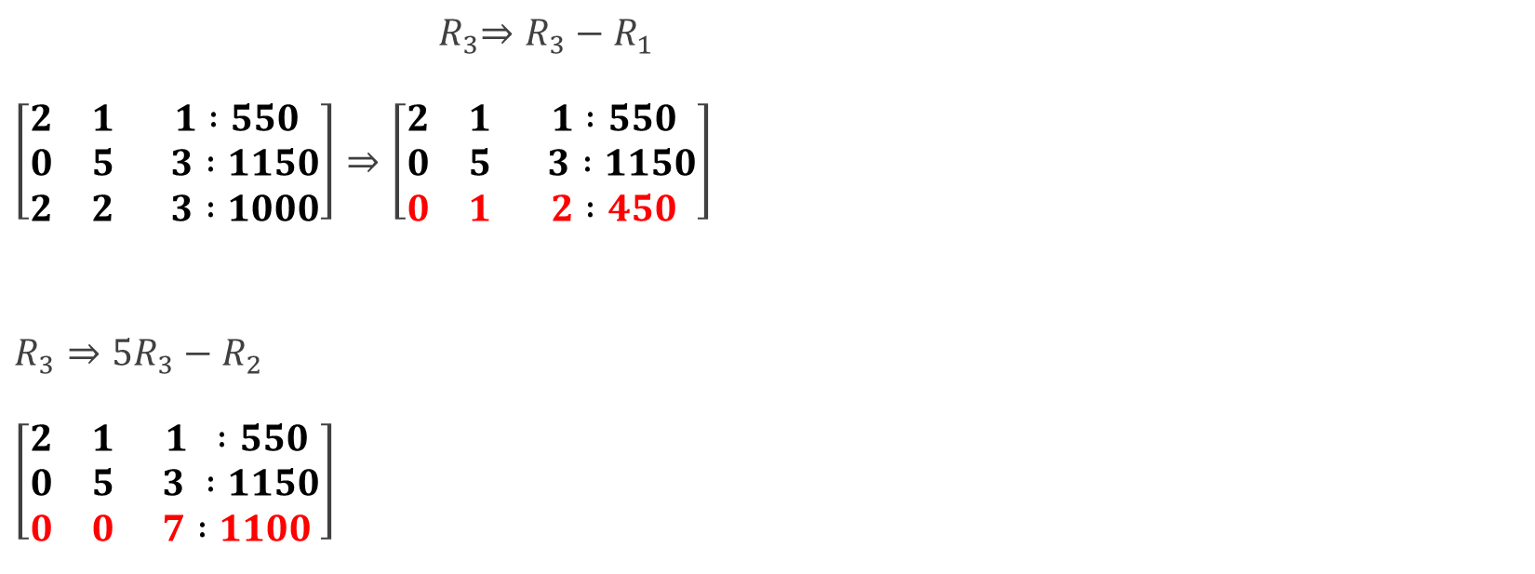
Gaussian Elimination (Best for hand-solving 3×3 or 4×4 systems)
${ R}_{3}⇒R_{3}−R_{1}$
$\left[\begin{matrix}2 & 1 & 1 :550 \\ 0 & 5 & 3 :1150 \\ 2 & 2 & 3 :1000\end{matrix}\right]⇒\left[\begin{matrix}2 & 1 & 1 :550 \\ 0 & 5 & 3 :1150 \\ 0 & 1 & 2 :450\end{matrix}\right]$
$R_{3}⇒{5R}_{3}−R_{2}$
$\left[\begin{matrix}2 & 1 & 1 :550 \\ 0 & 5 & 3 :1150 \\ 0 & 0 & 7 :1100\end{matrix}\right]$

Slide 22
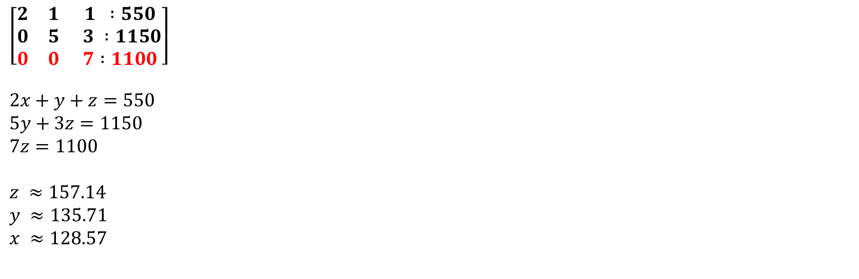
Gaussian Elimination (Best for hand-solving 3×3 or 4×4 systems)
$$\left[\begin{matrix}2 & 1 & 1 :550 \\ 0 & 5 & 3 :1150 \\ 0 & 0 & 7 :1100\end{matrix}\right]$$
$$2x+y+z=550$$
$$5y+3z=1150$$
$$7z=1100$$
$$z ≈157.14$$
$$y ≈135.71$$
$$x ≈128.57$$

Slide 23
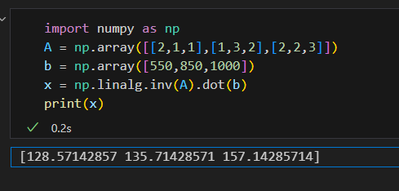
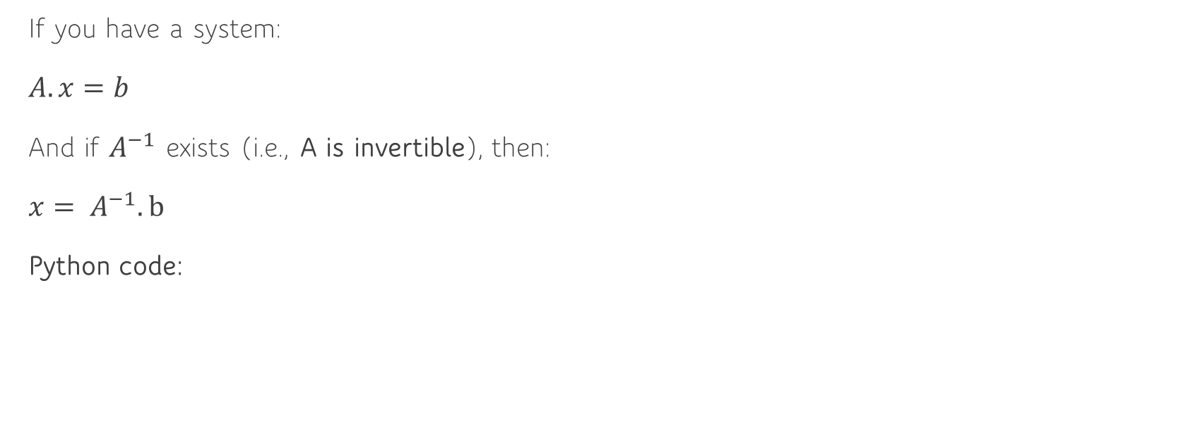
Matrix Inverse Method (Best when you have square, non-singular matrix A)
If you have a system:
$A.x=b$
And if $A^{−1}$ exists (i.e., A is invertible), then:
$x= A^{−1}.b$
Python code:

Slide 24
Summary Table
Method | Best for | Pros | Cons
Substitution | 2-variable systems | Simple, intuitive | Not scalable for large systems
Gaussian Elimination | 3–4 variable systems | Systematic, algorithmic | Tedious by hand beyond 4x4
Matrix Inverse | Square systems only | Fast with computers | Requires invertible matrix only

Slide 25
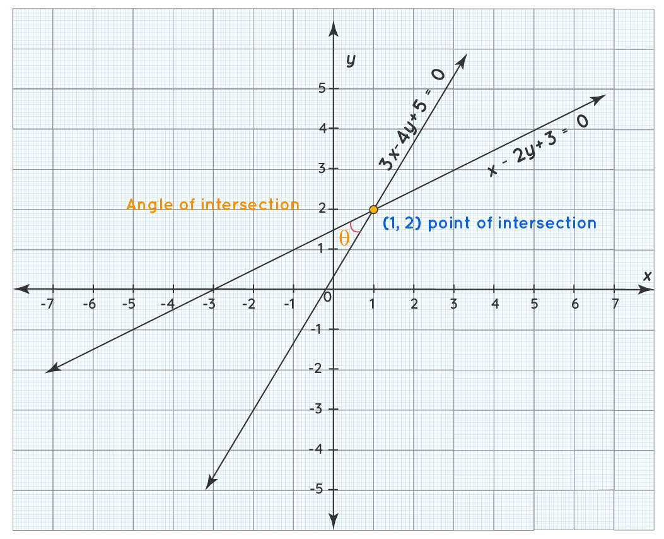
Conceptual Insights
A matrix is a compact way to represent multiple equations.
Solving Ax = b means finding a point where all equations intersect.
No solution → lines/planes don’t meet
Infinite solutions → they lie on a common plane
One solution → intersect at a point

Slide 26
Row Reduction and Echelon Form
Why we need these forms ?
To solve systems of linear equations systematically.
To find out whether a system has one solution, no solution, or infinitely many.
To make matrices easier to work with (e.g., for inverse, rank, nullspace).

Slide 27
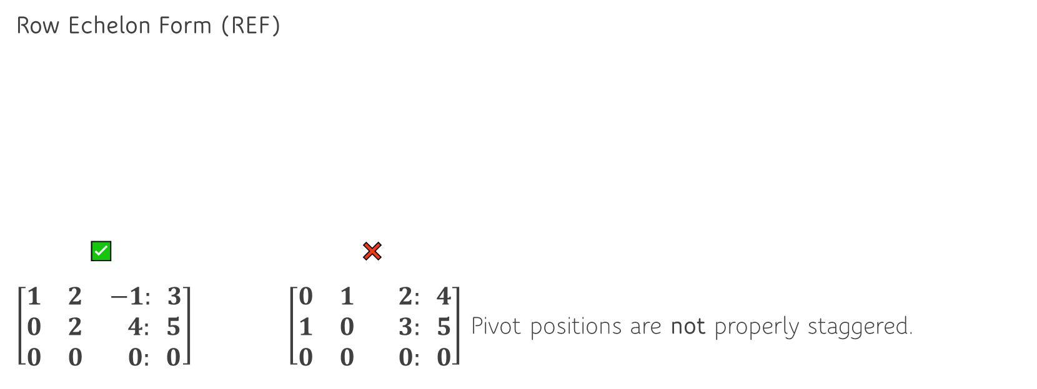
Row Reduction and Echelon Form
Row Echelon Form (REF)
✅ ❌
$\left[\begin{matrix}1 & 2 & −1: 3 \\ 0 & 2 & 4: 5 \\ 0 & 0 & 0: 0\end{matrix}\right]$ $\left[\begin{matrix}0 & 1 & 2: 4 \\ 1 & 0 & 3: 5 \\ 0 & 0 & 0: 0\end{matrix}\right]$ Pivot positions are not properly staggered.
Rules for Row Echelon Form (REF)
1: All non-zero rows are above any rows of all zeros.
2: The leading entry (first non-zero number from the left) of a row is to the right of the leading entry in the row above it.
3: All entries below a leading entry are zero.

Slide 28
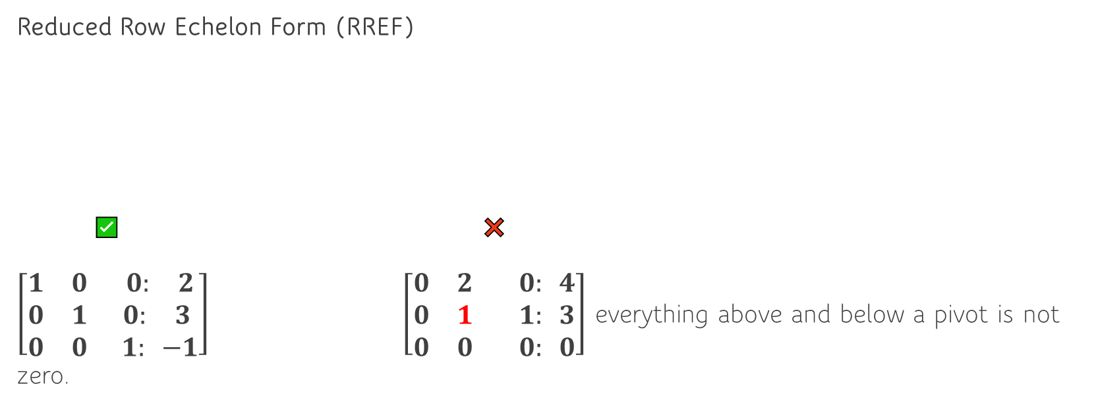
Row Reduction and Echelon Form
Reduced Row Echelon Form (RREF)
✅ ❌
$\left[\begin{matrix}1 & 0 & 0: 2 \\ 0 & 1 & 0: 3 \\ 0 & 0 & 1: −1\end{matrix}\right]$ $\left[\begin{matrix}0 & 2 & 0: 4 \\ 0 & 1 & 1: 3 \\ 0 & 0 & 0: 0\end{matrix}\right]$ everything above and below a pivot is not zero.
Rules for Reduced Row Echelon Form (RREF)
4 The leading entry in each row is 1 (called a pivot).
5 The pivot is the only non-zero entry in its column (i.e., everything above and below a pivot is zero).

Slide 29
Row Reduction and Echelon Form
Row Operations (The Tools)
3 legal operations:
Swap two rows
Multiply a row by a non-zero constant
Add or subtract a multiple of one row to another

Slide 30
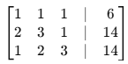
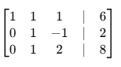
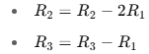
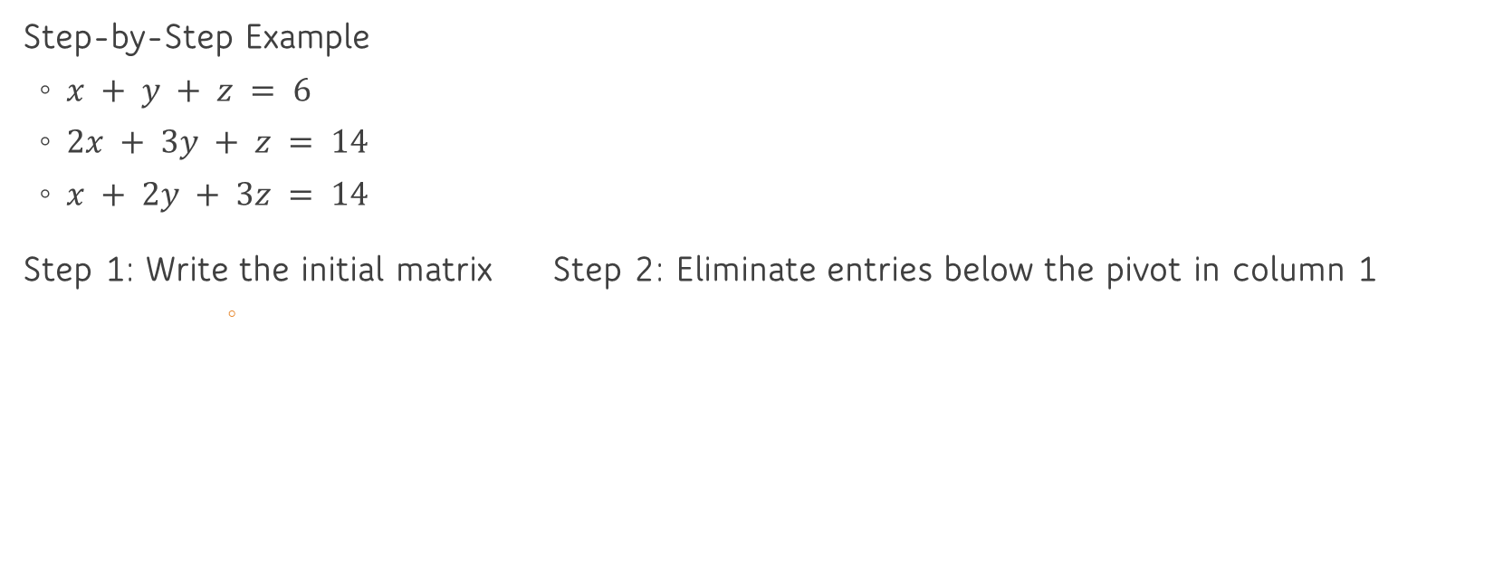
Row Reduction and Echelon Form
Step-by-Step Example
$x + y + z = 6$
$2x + 3y + z = 14$
$x + 2y + 3z = 14$
Step 1: Write the initial matrix Step 2: Eliminate entries below the pivot in column 1

Slide 31
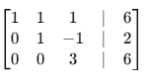
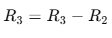
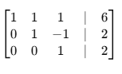
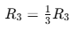
Row Reduction and Echelon Form
Step 3: Eliminate below the pivot in column 2
Step 4: Make pivot in row 3, column 3 a 1

Slide 32
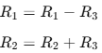
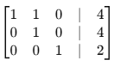
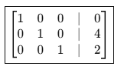
Row Reduction and Echelon Form
Step 5: Eliminate above the pivot in column 3
Step 6: Eliminate above the pivot in column 2

Slide 33
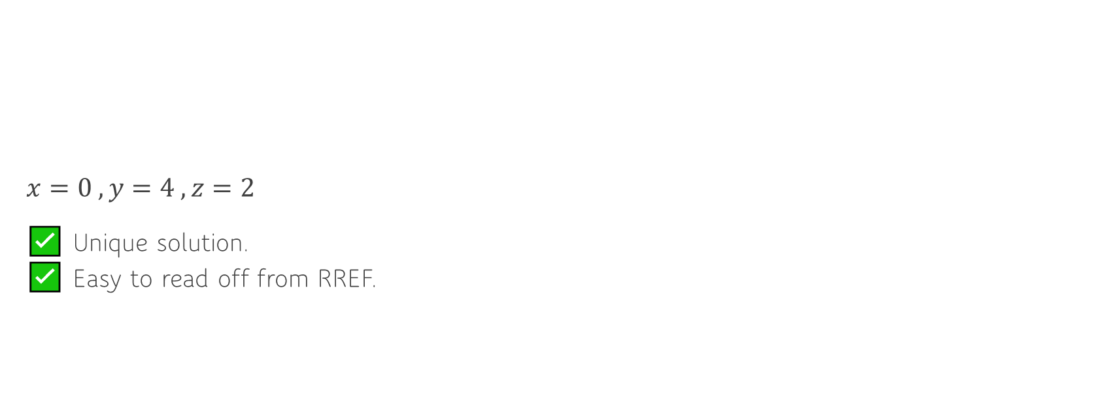
Row Reduction and Echelon Form
$x=0 , y=4 , z=2$
✅ Unique solution. ✅ Easy to read off from RREF.

Slide 34
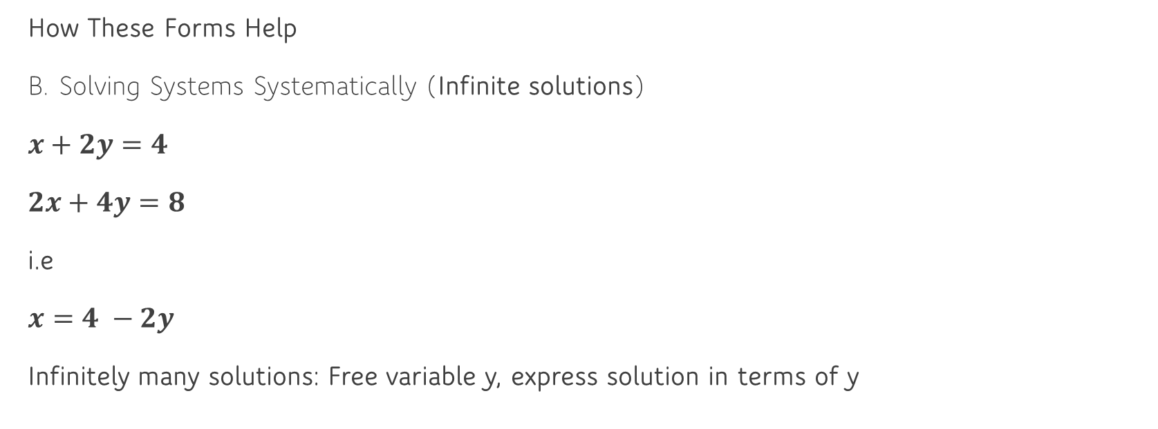
Row Reduction and Echelon Form
How These Forms Help
B. Solving Systems Systematically (Infinite solutions)
$x+2y=4$
$2x+4y=8$
i.e
$x=4 −2y$
Infinitely many solutions: Free variable y, express solution in terms of y

Slide 35
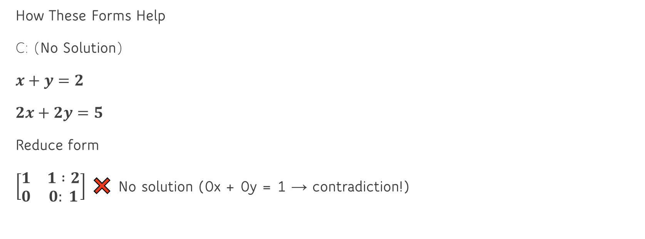
Row Reduction and Echelon Form
How These Forms Help
C: (No Solution)
$x+y=2$
$2x+2y=5$
Reduce form
$\left[\begin{matrix}1 & 1 :2 \\ 0 & 0: 1\end{matrix}\right]$ ❌ No solution (0x + 0y = 1 → contradiction!)

Slide 36
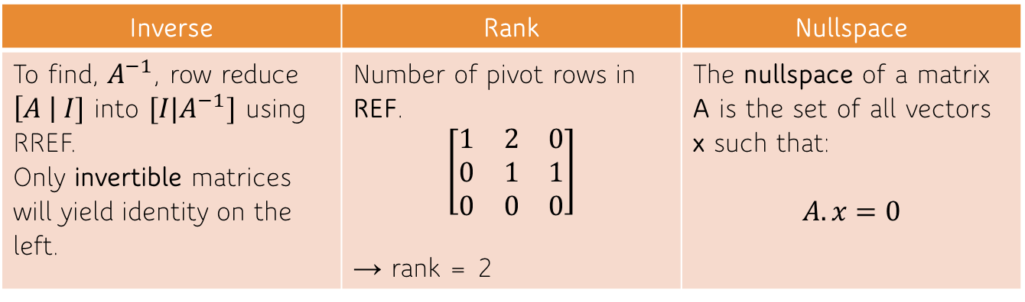
Row Reduction and Echelon Form
3. For Inverse, Rank, Nullspace
Inverse | Rank | Nullspace
To find, $A^{−1}\text{, }\text{row} \text{reduce}$ $\left[A \right| I]$ into $[I|A^{−1}]$ using RREF. Only invertible matrices will yield identity on the left. | Number of pivot rows in REF. $$\left[\begin{matrix}1 & 2 & 0 \\ 0 & 1 & 1 \\ 0 & 0 & 0\end{matrix}\right]$$ → rank = 2 | The nullspace of a matrix A is the set of all vectors x such that: $$A.x=0$$

Slide 37
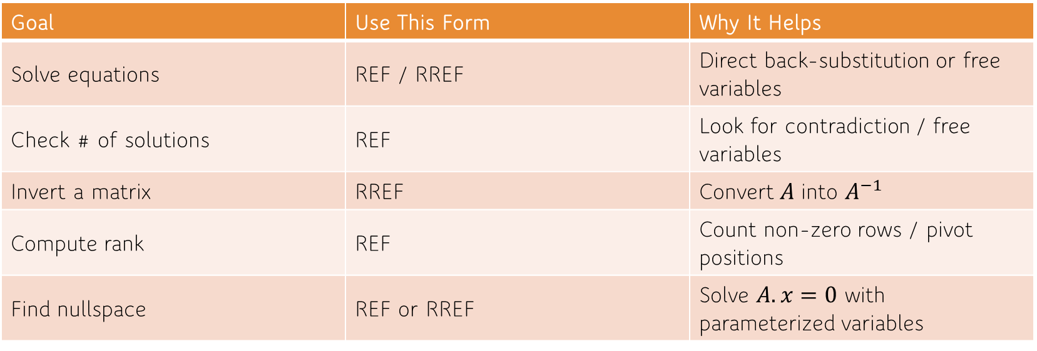
Row Reduction and Echelon Form (Summary)
Goal | Use This Form | Why It Helps
Solve equations | REF / RREF | Direct back-substitution or free variables
Check # of solutions | REF | Look for contradiction / free variables
Invert a matrix | RREF | Convert$A$ into $A^{−1}$
Compute rank | REF | Count non-zero rows / pivot positions
Find nullspace | REF or RREF | Solve $A.x=0$ with parameterized variables

Slide 38

Vector Spaces and Subspaces
1. What Is a Vector Space?
A vector space is a collection of objects called vectors that can be added together
and multiplied (scaled) by numbers (called scalars) while following certain rules.
💡 Think of vectors as arrows or lists of numbers. A vector space is like a “world”
where these vectors live and behave nicely with addition and scaling.
Real-life analogy:
Imagine a flat sheet of paper that extends infinitely in all directions (like ℝ²). Any arrow you draw starting from the origin and pointing somewhere on the sheet is a vector. All possible such arrows make up a vector space.

Slide 39
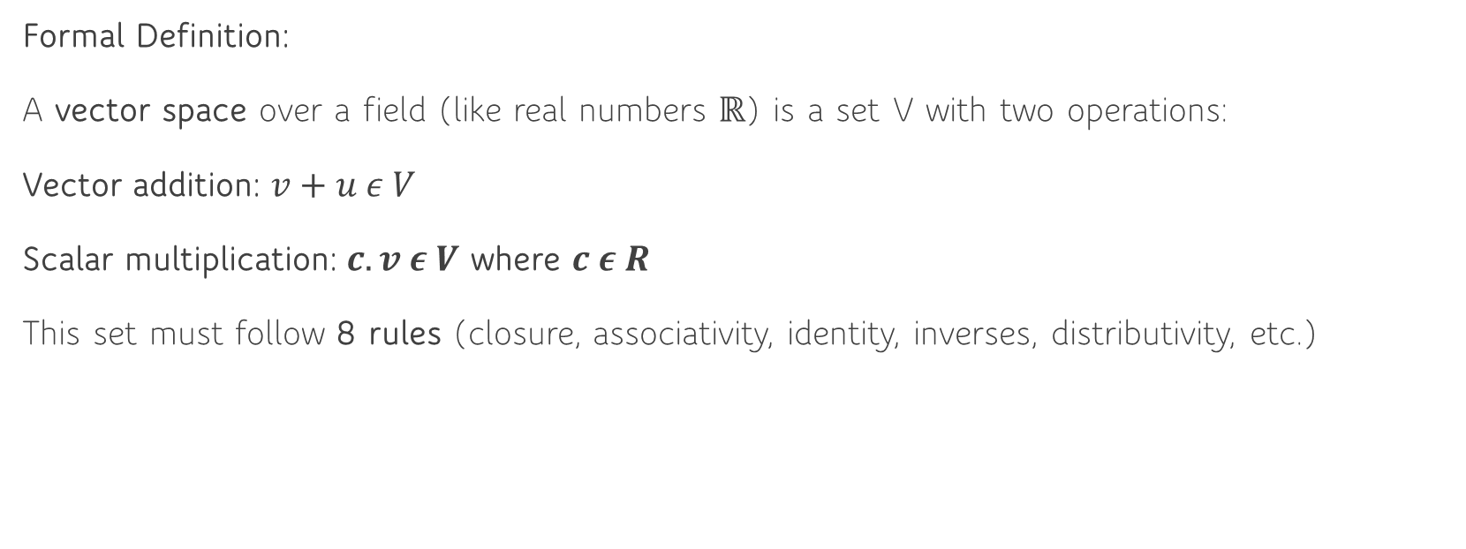
Vector Spaces and Subspaces
Formal Definition:
A vector space over a field (like real numbers ℝ) is a set V with two operations:
Vector addition: $v+u ε V$
Scalar multiplication: $c.v ε V$ where $c ε R$
This set must follow 8 rules (closure, associativity, identity, inverses, distributivity, etc.)

Slide 40
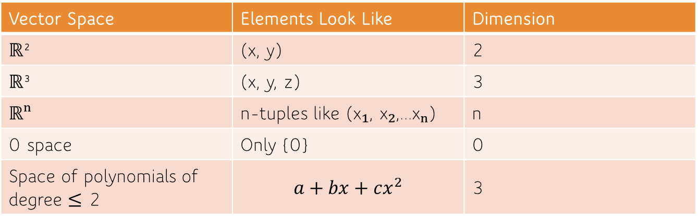
Vector Spaces and Subspaces
3. Examples of Vector Spaces:
Vector Space | Elements Look Like | Dimension
ℝ² | (x, y) | 2
ℝ³ | (x, y, z) | 3
ℝⁿ | n-tuples like (x₁, x₂,...xₙ) | n
0 space | Only {0} | 0
Space of polynomials of degree ≤ 2 | $$a+bx+cx^{2}$$ | 3

Slide 41
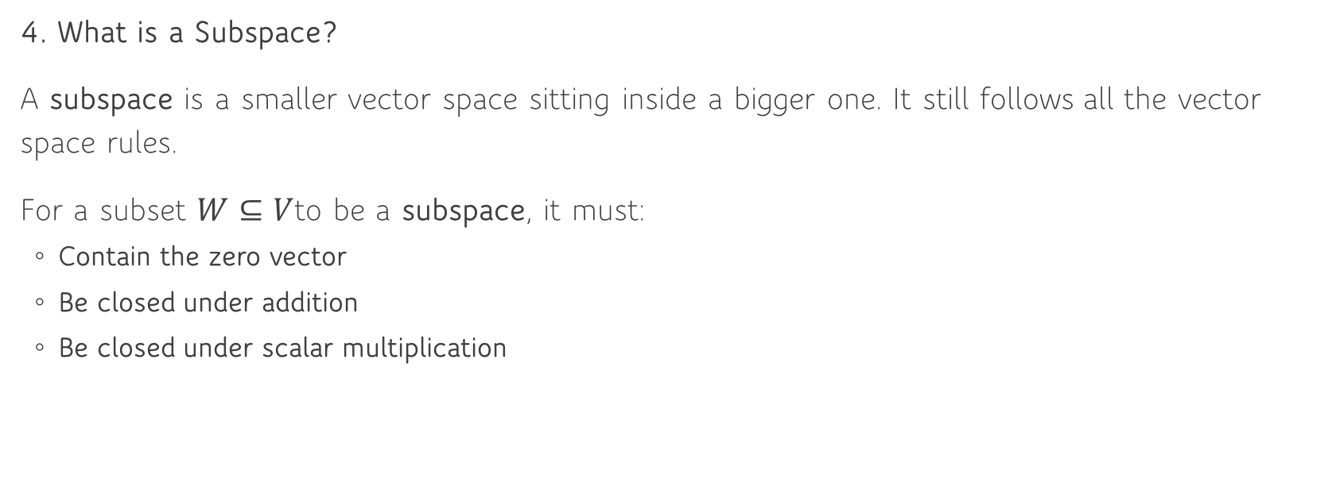
Vector Spaces and Subspaces
4. What is a Subspace?
A subspace is a smaller vector space sitting inside a bigger one. It still follows all the vector space rules.
For a subset $W⊆V$to be a subspace, it must:
Contain the zero vector
Be closed under addition
Be closed under scalar multiplication

Slide 42
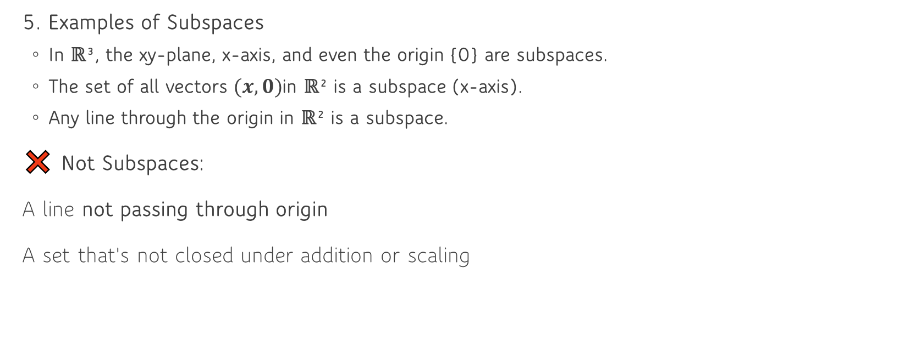
Vector Spaces and Subspaces
5. Examples of Subspaces
In ℝ³, the xy-plane, x-axis, and even the origin {0} are subspaces.
The set of all vectors $(x, 0)$in ℝ² is a subspace (x-axis).
Any line through the origin in ℝ² is a subspace.
❌ Not Subspaces:
A line not passing through origin
A set that's not closed under addition or scaling

Slide 43
Vector Spaces and Subspaces
How to Check If Something Is a Subspace?
Use the 3 Subspace Tests:
Is the zero vector included?
Is it closed under vector addition?
Is it closed under scalar multiplication?
Conceptual Insight
A vector space is about freedom to move in certain directions using linear combinations.
A subspace is about restricting movement to fewer directions (still using linear combinations).

Slide 44
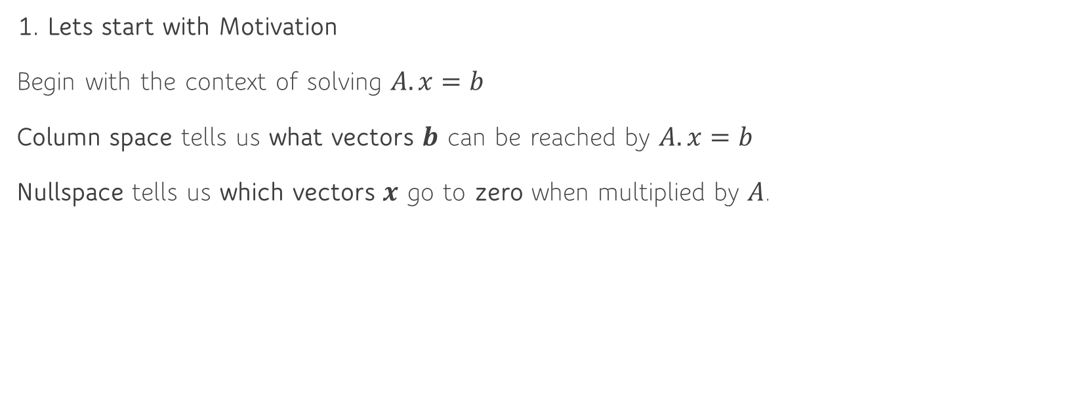
Column Space and Nullspace
1. Lets start with Motivation
Begin with the context of solving $A.x=b$
Column space tells us what vectors $b$ can be reached by $A.x=b$
Nullspace tells us which vectors $x$ go to zero when multiplied by $A$.

Slide 45
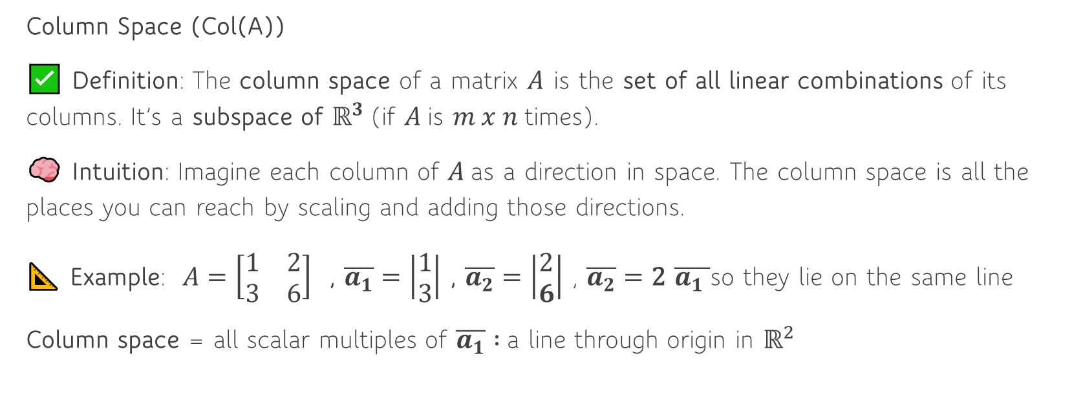
Column Space and Nullspace
Column Space (Col(A))
✅ Definition: The column space of a matrix $A$ is the set of all linear combinations of its columns. It’s a subspace of $ℝ^{3}$(if $A$is $m x n$times).
🧠 Intuition: Imagine each column of $A$as a direction in space. The column space is all the places you can reach by scaling and adding those directions.
📐 Example: $A=\left[\begin{matrix}1 & 2 \\ 3 & 6\end{matrix}\right]$ , $\overline{a_{1}}=\left|\begin{aligned}1 \\ 3\end{aligned}\right|$ , $\overline{a_{2}}=\left|\begin{aligned}2 \\ 6\end{aligned}\right|$ ​, $\overline{a_{2}}=\text{2} \overline{a_{1} }$so they lie on the same line
Column space = all scalar multiples of $\overline{a_{1}} :$a line through origin in $ℝ^{2}$

Slide 46
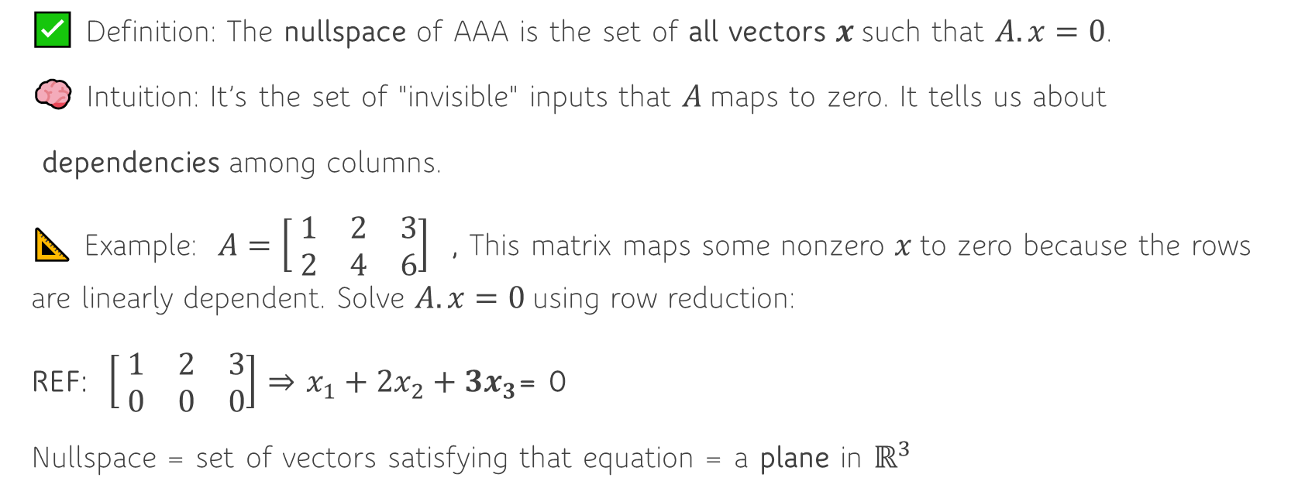
Nullspace (Nul(A))
✅ Definition: The nullspace of AAA is the set of all vectors $x$such that $A.x=0$.
🧠 Intuition: It’s the set of "invisible" inputs that $A$maps to zero. It tells us about
dependencies among columns.
📐 Example: $A=\left[ \begin{matrix}1 & 2 & 3 \\ 2 & 4 & 6\end{matrix}\right]$ , This matrix maps some nonzero $x$to zero because the rows are linearly dependent. Solve $A.x=0$using row reduction:
REF: $\left[ \begin{matrix}1 & 2 & 3 \\ 0 & 0 & 0\end{matrix}\right]$ ⇒ ​$x_{1}+2x_{2}+3x_{3}$= 0
Nullspace = set of vectors satisfying that equation = a plane in $ℝ^{3}$

Slide 47
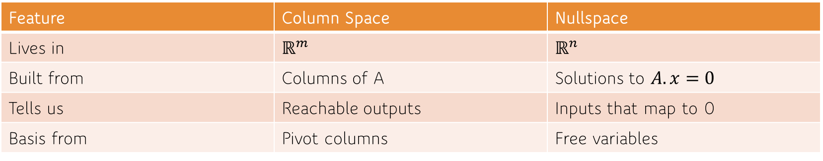
Contrast the Two:
Feature | Column Space | Nullspace
Lives in | $$ℝ^{m}$$ | $$ℝ^{n}$$
Built from | Columns of A | Solutions to $A.x=0$
Tells us | Reachable outputs | Inputs that map to 0
Basis from | Pivot columns | Free variables

